Slide 1
Ada Boosting Alogrithm

Slide 2
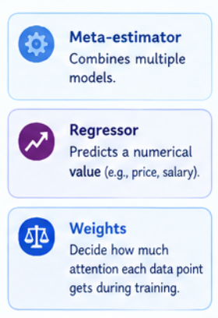
What is adaboost regressor?
AdaBoost regressor is a meta-estimator that builds Multiple weak regressors, one after another, giving More focus (higher weight) to the data points that
Are predicted badly.

Slide 3
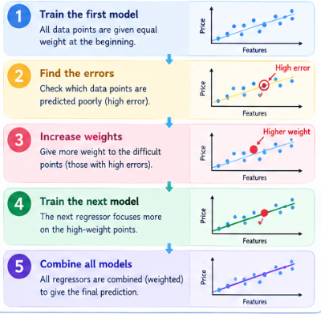
How adaBoost works?

Slide 4
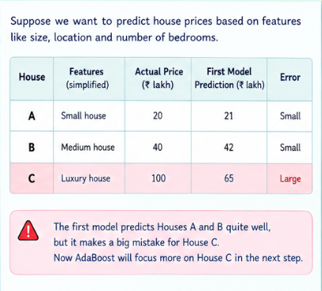
Eg: ada boost with house prices prediction

Slide 5
XG Boosting Algorithm

Slide 6
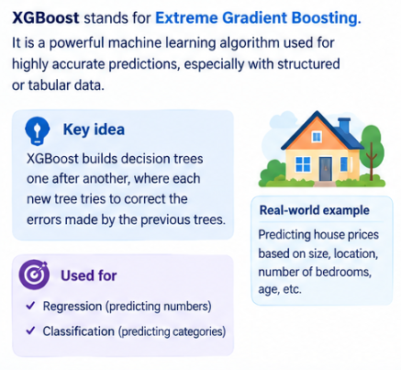
What is xg boosting ?

Slide 7
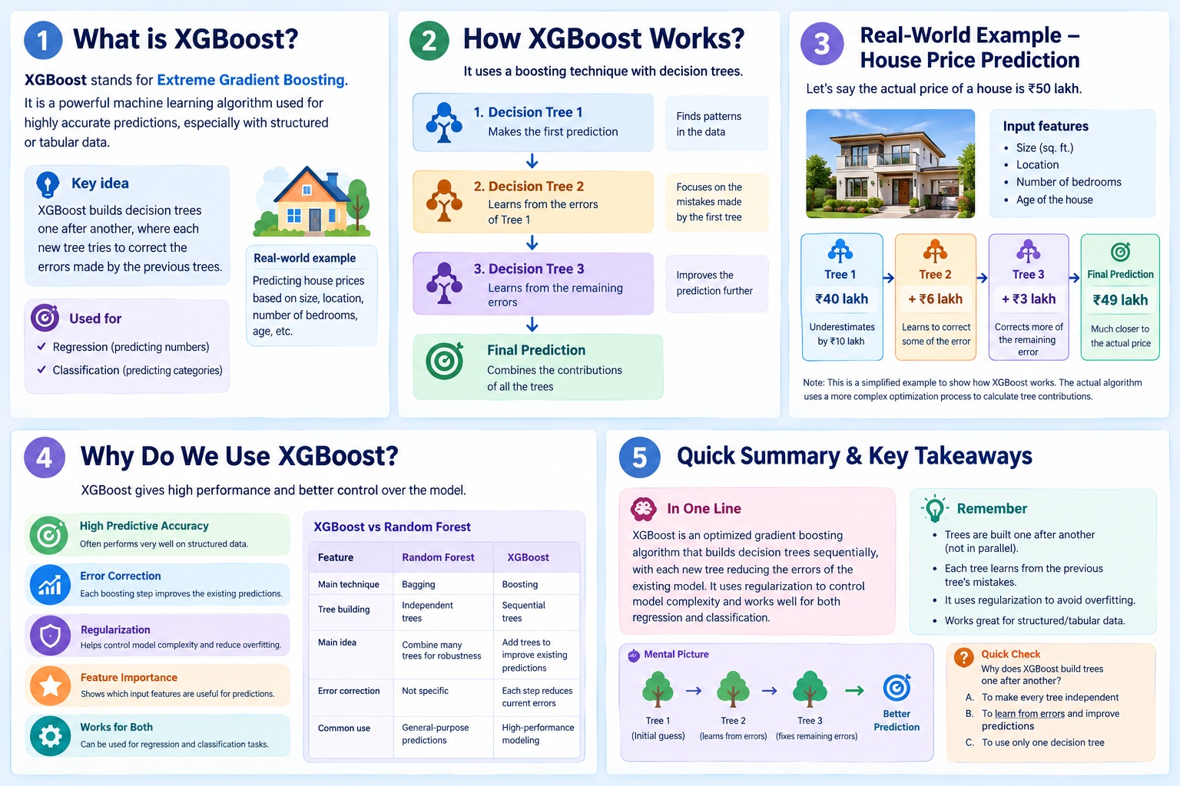
How XG boost works?

Slide 8
Eg: House price prediction using xg boost

Slide 10
LG Boosting Algorithm

Slide 11
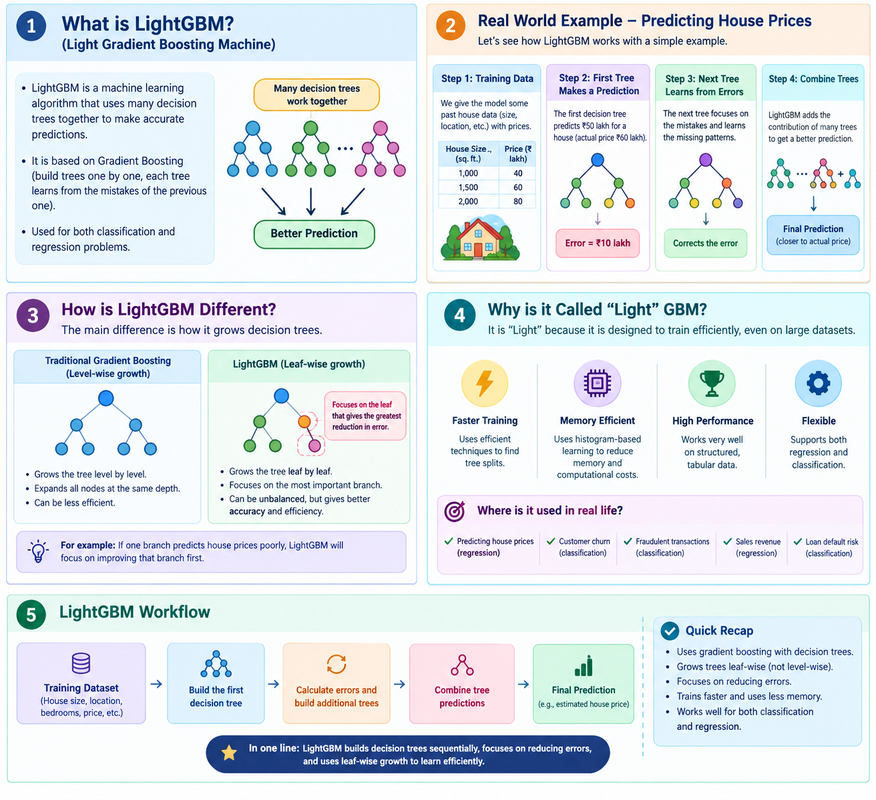
What is LG Boosting?

Slide 12
How LG boost works?

Slide 13
Advantage of LG boost

